Slide 1
Taylan Özgür Elma Web Programing Final Assignment MSN News Site
Student ID:21070006003

Slide 2
Technologies I Used: Backend: Django (Python Framework) Frontend: HTML/CSS/Bootstrap/Javascript Database: MYSQL

Slide 3
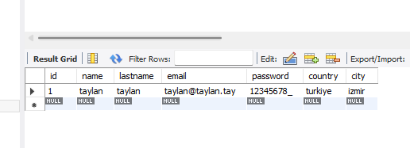
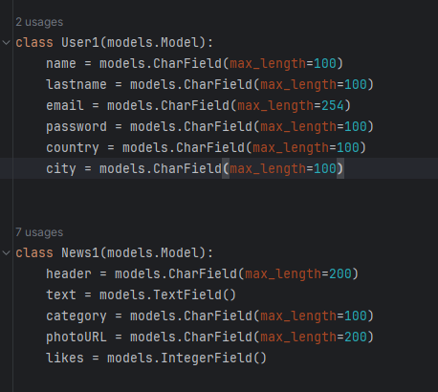
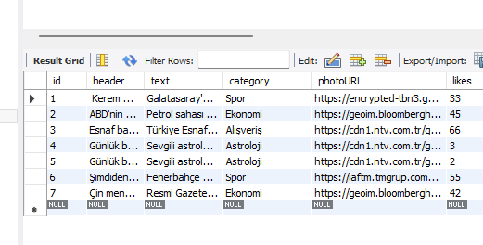
Database Structure:

Slide 4
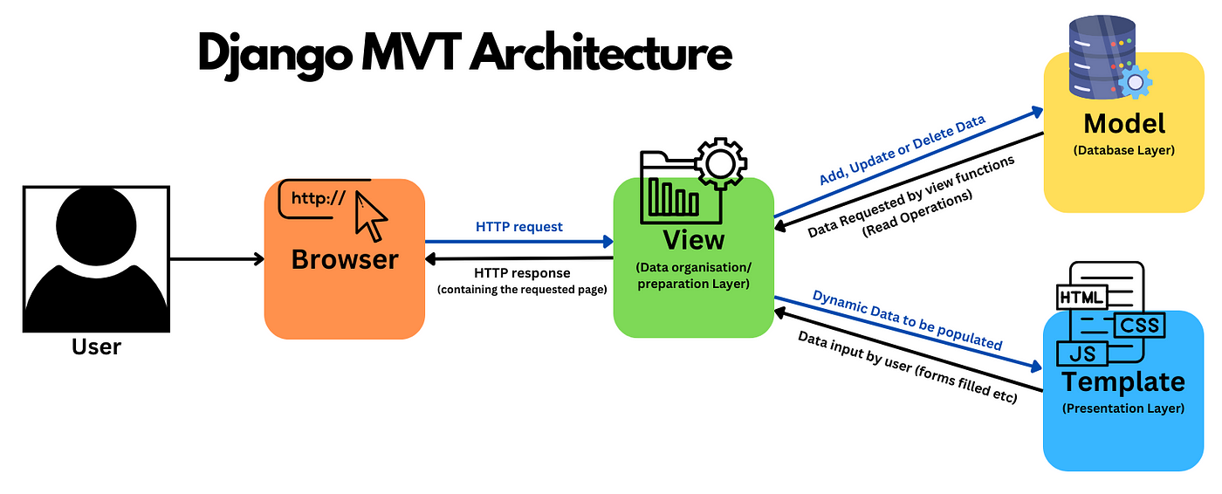
Design Pattern: MVT

